Slide 1
Employee Attrition: What makes an employee quit?
Christopher Boomhower, Stacey Fabricant, Alex Frye, David Mumford, Michael Smith, Lindsay Vitovsky
Notes:
Hello, and thank you for attending our presentation today.

Slide 2
Can we predict that an
employee will quit?
Notes:
Our team set out to develop a model that predicts whether or not an employee will quit. But before we review our methodology, and whether or not we were successful, you might be asking yourself, “Why would this matter?” (Time: 15 sec)

Slide 3
The Problem
Costly to many organizations
1. Boushey, H. and S. J. Glyn. "Cost of Turnover." Center for American Progress. 2012
2. Allen, D. , PhD. "Retaining Talent – A guide to analyzing and managing employee turnover." SHRM Foundation’s Effective Practice Guidelines Series. 2009.
3. Mohr, R. and C. Zoghi. "High Involvement Work Design and Job Satisfaction." ILR Review, Vol. 61, No. 3, pp. 275-296. Sage Publications, Inc. 2008.
4. Richardson, R. "Measuring the Impact of of Turnover on Sales." The Journal of Personal Selling and Sales Management, Vol. 19, No. 4, pp. 53-66. Taylor & Francis, Ltd. 1999.
Notes:
Firstly, losing an employee when they are still of value to an organization, comes at a cost. The employee might be leaving for just a few thousand dollars more per year in salary, but to an organization, that cost has been estimated

Slide 4
The Problem
Costly to many organizations
20% - 200%+ of an employee’s annual salary
1. Boushey, H. and S. J. Glyn. "Cost of Turnover." Center for American Progress. 2012
2. Allen, D. , PhD. "Retaining Talent – A guide to analyzing and managing employee turnover." SHRM Foundation’s Effective Practice Guidelines Series. 2009.
3. Mohr, R. and C. Zoghi. "High Involvement Work Design and Job Satisfaction." ILR Review, Vol. 61, No. 3, pp. 275-296. Sage Publications, Inc. 2008.
4. Richardson, R. "Measuring the Impact of of Turnover on Sales." The Journal of Personal Selling and Sales Management, Vol. 19, No. 4, pp. 53-66. Taylor & Francis, Ltd. 1999.
Notes:
to be anywhere from 20, to over two hundred percent of an employee’s salary. The resources it takes to find, hire, then develop a replacement long term can cause a very real effect to a company’s bottom line.

Slide 5
The Problem
Costly to many organizations
20% - 200%+ of an employee’s annual salary
Predicting human behavior
1. Boushey, H. and S. J. Glyn. "Cost of Turnover." Center for American Progress. 2012
2. Allen, D. , PhD. "Retaining Talent – A guide to analyzing and managing employee turnover." SHRM Foundation’s Effective Practice Guidelines Series. 2009.
3. Mohr, R. and C. Zoghi. "High Involvement Work Design and Job Satisfaction." ILR Review, Vol. 61, No. 3, pp. 275-296. Sage Publications, Inc. 2008.
4. Richardson, R. "Measuring the Impact of of Turnover on Sales." The Journal of Personal Selling and Sales Management, Vol. 19, No. 4, pp. 53-66. Taylor & Francis, Ltd. 1999.
Notes:
Another purpose for our research is concerning the dynamic world of predicting human behavior. To do this, we needed access to data sets that were not only large enough, but also diverse in their collection of various employee attributes. We found

Slide 6
Data Source
Office of Personnel Management (OPM)
October 2015 – September 2014
Bureau of Labor Statistics (BLS)
IBM
1. Office of Personnel Management. “Separations Data." url: https://www.opm.gov/data/.
2. Bureau of Labor Statistics: “Federal Job Employment data” url: https://www.bls.gov/help/def/jl.htm#rate/level
3. IBM Watson Analytics. “Sample Data: HR Employee Attrition and Performance.." url: https://www.ibm.com/communities/ analytics/watson-analytics-blog/hr-employee-attrition/.
Notes:
…out data that we needed by combining and supplementing with these three resources. From OPM, we used employee separation data collected over four quarters, and combined that with BLS data. Finally, a

Slide 7
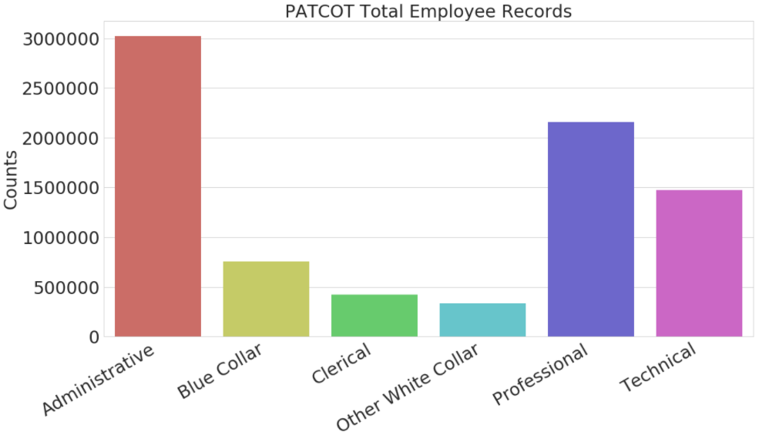
OPM Data: Job Categories
Professional & Administrative candidate types for modeling
Notes:
To best parallel public sector modeling with private sector jobs, we first investigated OPM occupation categories. In so doing, we found Administrative and Professional categories to have the largest number of observations and most applicable job descriptions.

Slide 8
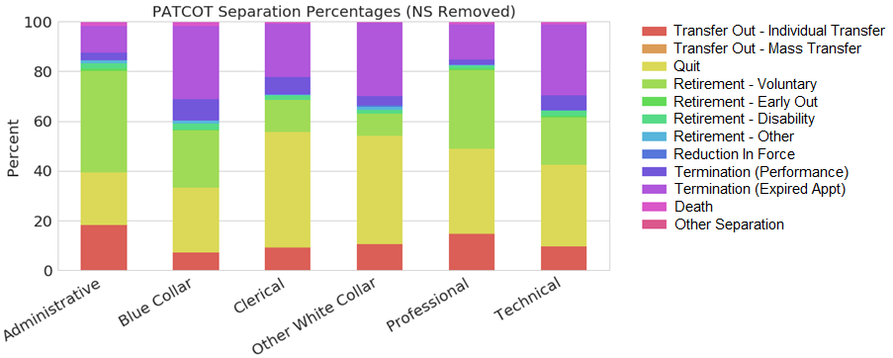
OPM Data: Separation Types
Various separation types
Telling Quit / Retirement ratios
Notes:
Our raw data also consisted of 12 separation types, ranging from transfers or retirement, to even death or layoffs. When comparing types among job categories, we discovered a nearly even number of employees retiring as those quitting in Professional and Administrative jobs.

Slide 9
OPM Data: Separation Types
Primary separation types of interest
Non-Separation (NS)
Quits (SC)
Transfers & Retirements combined with Non-Separation
Uncontrollable types dropped
Notes:
Given our ultimate goal of only predicting attrition, we simplified our response types to only Quits vs. everything else, or Non-Separation. This means transfers and retirements were combined with Non-Separation, while dropping types such as death.

Slide 10
OPM Data: Sampling
Professional and Administrative jobs
7,500 observations per separation type
Proportionally allocated sampling
Date strata
Age strata
Final sample sizes
Professional – 14,922
Administrative – 14,918
Notes:
Our model would be developed and tested for professional jobs but applied to administrative jobs as well. Observation counts were capped at 7,500 per separation type and sampled via proportional allocation. Observation counts were sampled via proportional allocation on date and age strata. Final sample sizes were just under 15k for each job category.

Slide 11
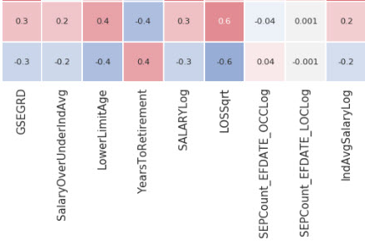
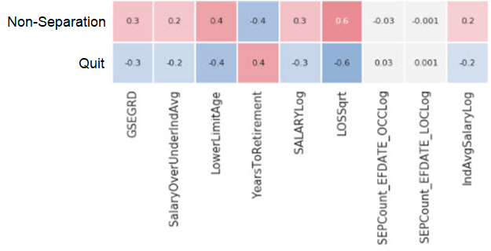
Initial Findings
Correlations – Non-BLS Numeric attributes
Length of service and age
(Values in matrix rounded to first non-zero digit)
Notes:
Some interesting characteristics were uncovered when reviewing non-BLS numeric attributes. Each independent variable’s correlation with separation was nearly mirrored, with length of service and age-related attributes portraying greatest correlation.

Slide 12
Classification Methods
Three primary algorithms developed
Random Forest
KNN (Kd-tree)
Logistic Regression
Feature selection critical – 99 dimensions
Notes:
With these correlations in mind, we proceeded with model development. Our classification phase consisted not only of developing random forest, K-Nearest-Neighbor, and logistic regression models, but it also consisted of reducing our 99 dimensions.

Slide 13
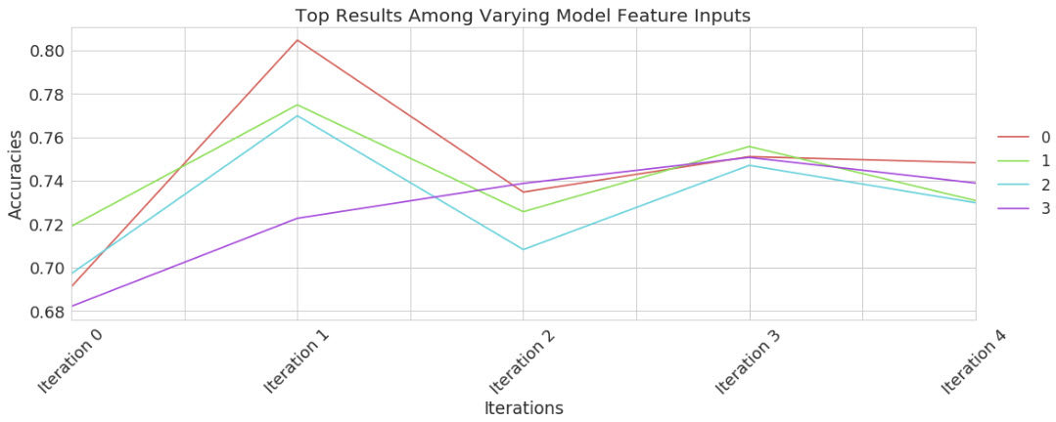
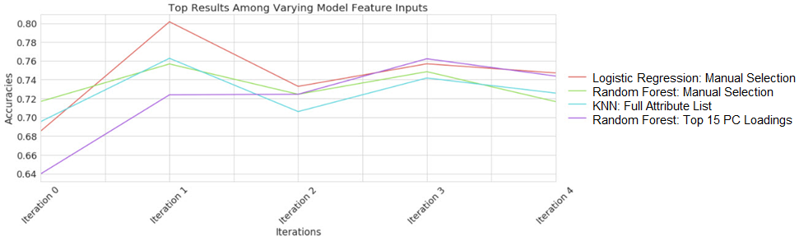
Classification Methods
Three primary feature input variations
Full attribute list
Top 15 Principle Component loadings
Manual selection (VIF, Log-Likelihood, etc.)
LR Mean Accuracy = 74.6%
Notes:
While implementing these algorithms, we compared performance when inputting various combinations of our 99 features. With 5-fold cross-validation, Logistic Regression was our model winner, with a mean accuracy of 74.48%

Slide 14
Logistic Regression Key Predictors
Three primary key predictor types
Length of Service (Sqrt Transformation)
Age
Pay Group
Odds Ratios
▼ ▼ ▼ ▼ with each unit LOSSqrt
▲▼ with age bracket
▼ for standard pay plan
Notes:
In reviewing the model’s most impactful features, we uncovered a significant reduction in odds of an employee quitting after the first year of service, odds increase or decrease depending on employee age, and odds of quitting are less if the employee is in the standard pay plan.

Slide 15
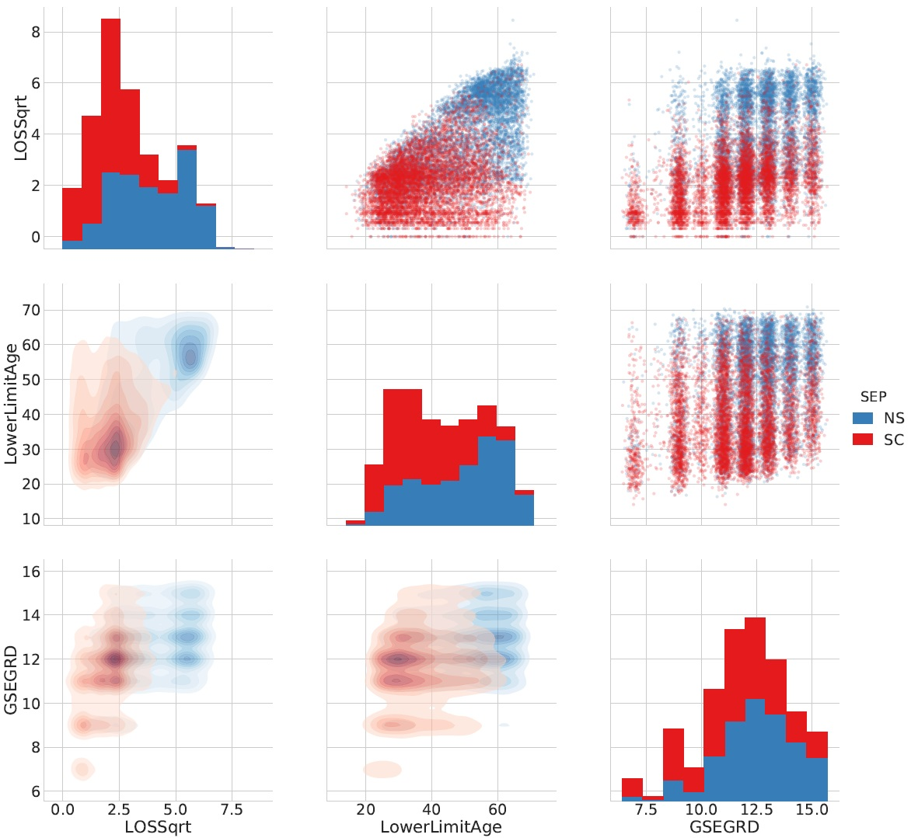
Feature Selection & Analysis
Age aside, quits spike around 6.25 years of service
Non-Separation concentrates in younger ages
Notes:
We strove to more thoroughly understand these odds by reviewing the data in the form of kernel-density and scatter plots. Comparing age and length of service, we found quits spike around an untransformed 6.25 years of service, regardless of age. We also found…

Slide 16
Feature Selection & Analysis
Non-Separation concentrates in younger ages
Length of service stronger predictor than pay grade or age
Notes:
… that not only does non-separation concentrate with many years of experience, it does at very young ages as well, corresponding with our model’s reduced odds for ages less than 30. Finally, length of service really is a stronger predictor of attrition than age or pay grade.

Slide 17
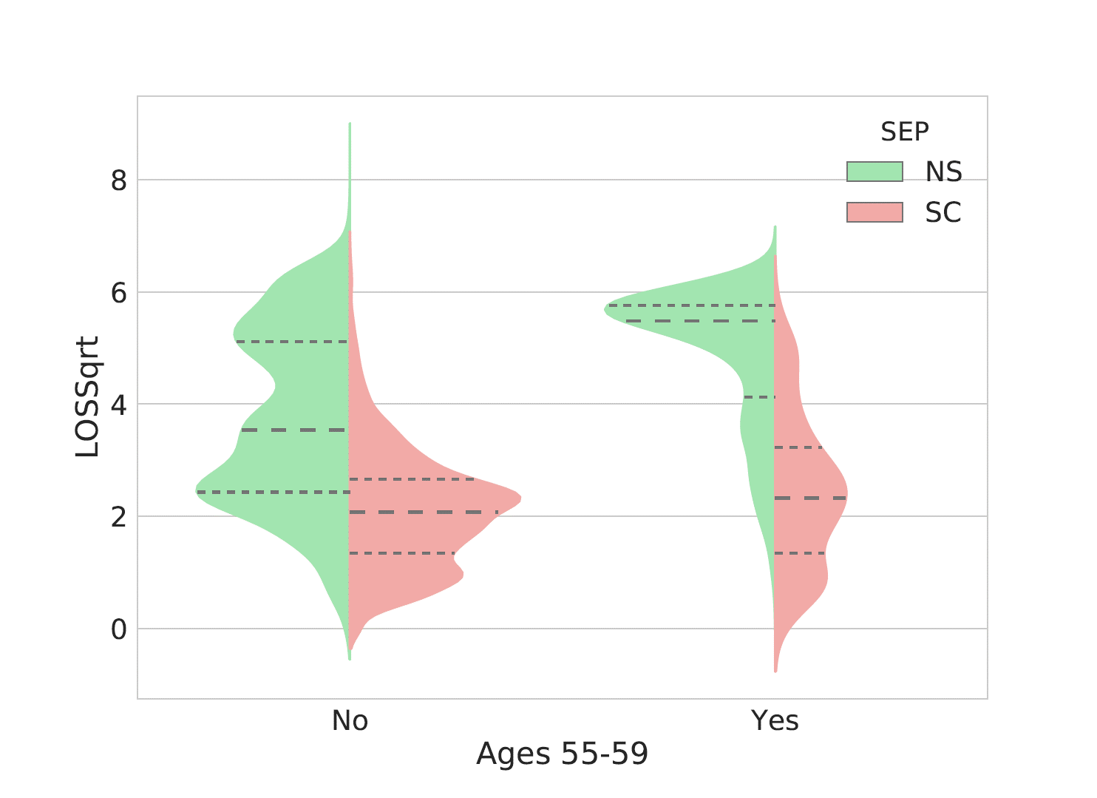
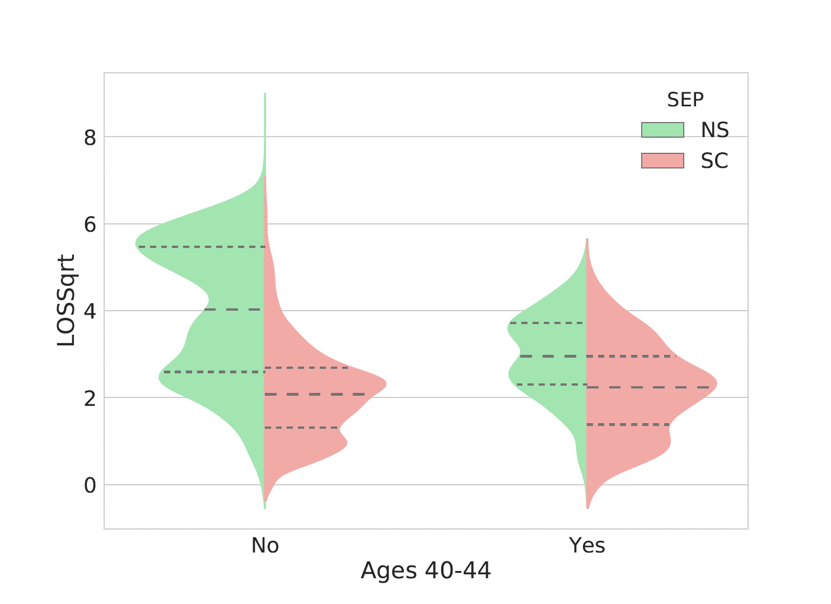
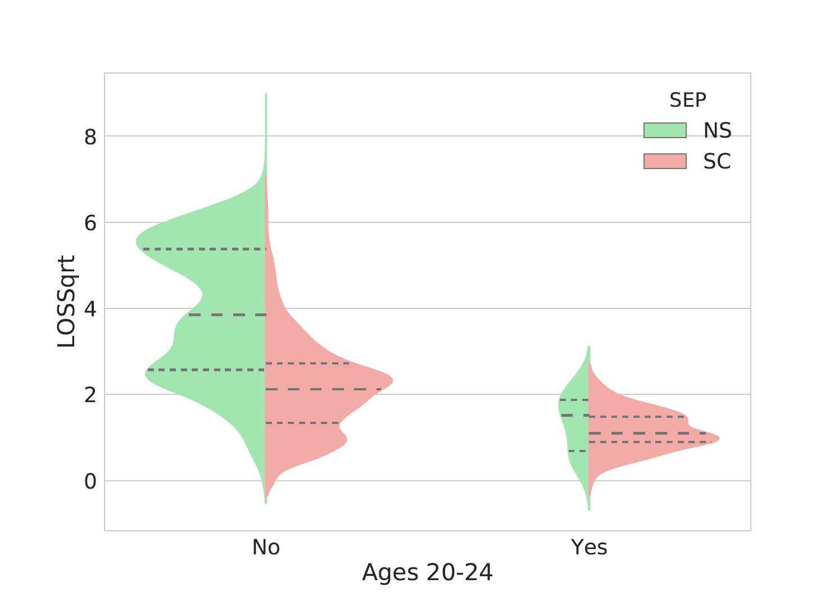
Feature Selection & Analysis
Service length stronger than age
75th percentile of quitting (SC) ≤ 50th percentile of non-separation (NS)
Notes:
Lastly, we’d like to briefly touch on the relationship between length of service and age brackets using violin plots split on separation type. Analysis further confirms service length is a stronger predictor than age as far more quits occur with less years of service regardless of age.

Slide 18
Ethical Dilemmas
Our model in the hiring process
Age discrimination
"Shelf-life"
Exploitive/Reductive Policy Making
Vested Benefits
Quality of Life Policies
Notes:
We recognize that this model could be used in the hiring process to weed out candidates that don't statistically favor long term employment. It could also lead to policy changes that minimize the company's losses by increasing the time needed for employees to be fully vested or promote quality of life policing that could do more harm than good.

Slide 19
Ethical Solutions
Identify attrition-likely employees
Begin a dialog with individuals
Build out support within HR and your community
Notes:
What we should do with this model is identify attrition-likely groups which allows employers to focus on helping the greatest number of people. Like most ethical problems, this begins with communication – not all employees leave for the same reason - but with a supportive environment, it's possible the reasons for attrition can be mitigated.

Slide 20
Conclusion & Additional Research
Areas for additional research:
Location through Income Inflation Margins
Raw Age Values
Employee Benefit Data
Attrition data with no pension set aside

Slide 21
Conclusion & Additional Research
Must apply through an ethical lens
Seek to provide value to employees’ lives
Consider who stands to benefit
Improve profitability without sacrificing employee goals

